Slide 1
Object Oriented Programming
{
< Shreerang Mhatre == 52
Sarvesh Gurav == 44 Tanvi Kariyappa == 56 >
}
...

Slide 2
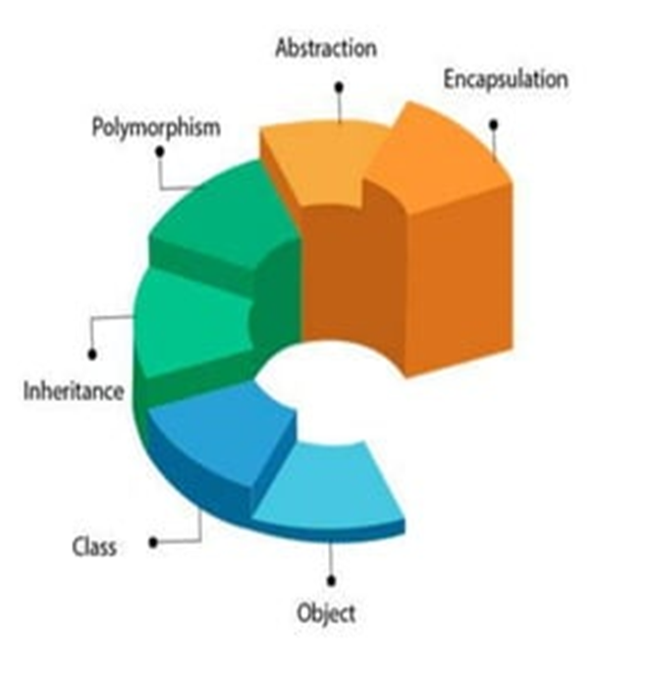
Introduction
The object-oriented paradigm is a programming methodology that promotes the efficient design and development of software systems using reusable components that can be quickly and safely assembled into larger systems.
The main aim of object-oriented programming is to
implement real- world concepts like
Objects | Real world entity
Classes | Templates/ Blueprints
Encapsulation | Bundling of Data
Abstraction | Visibility Controls
Inheritance | Backward Compatibility , parent child relation
Polymorphism | Many forms

Slide 3
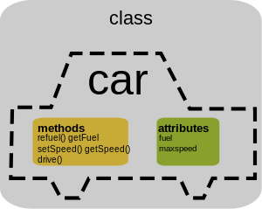
Class
{
..
A class is a group of objects which have common properties. It is a template or blueprint from which objects are created. It is a logical entity.
-It is non primitive data type.
-It cant be physical(no memory space)
-Class members are access modifiers,
objects, Methods, Instance variable
and constructors.
*
}
..

Slide 4
Example: Class
Created a class called "MyClass":
class MyClass { // The class public: // Access specifier int myNum; // Attribute (int variable) string myString; // Attribute (string variable) };

Slide 5
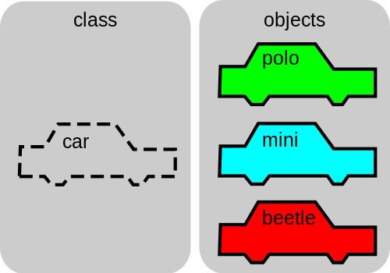
Object
{
..
An Object can be defined as an instance of a class. An object contains an address and takes up some space in memory. Objects can communicate without knowing the details of each other's data or code. The only necessary thing is the type of message accepted and the type of response returned by the objects.
}
..

Slide 6
Example: Object
class MyClass { // The class public: // Access specifier int myNum; // Attribute (int variable) string myString; // Attribute (string variable) }; int main() { MyClass myObj; // Create an object of MyClass // Access attributes and set values myObj.myNum = 15; myObj.myString = "Some text"; // Print attribute values cout << myObj.myNum << "\n"; cout << myObj.myString; return 0; }

Slide 7
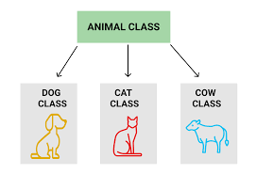
Inheritance
*
{
Inheritance is a mechanism in which one Object acquires all the properties and behaviors of a parent object.
Inheritance represents the IS-A relationship which is also known as a parent-child relationship.
Like Animal is a Mammals , Reptiles or Birds.
Reusability: As the name specifies, reusability is a mechanism which facilitates you to reuse the fields and methods of the existing class when
you create a new class. You can use the same fields and
methods already defined in the previous class.
Types Of inheritance:
→ Single
→ Multilevel
→ Hierarchical
→ Multiple
→ Hybrid
}

Slide 8
Example: Inheritance
{
// Base class class Vehicle { public: string brand = "Ford"; void honk() { cout << "Tuut, tuut! \n" ; } }; // Derived class class Car: public Vehicle { public: string model = "Mustang"; };
int main() { Car myCar; myCar.honk(); cout << myCar.brand + " " + myCar.model; return 0; }
}

Slide 9
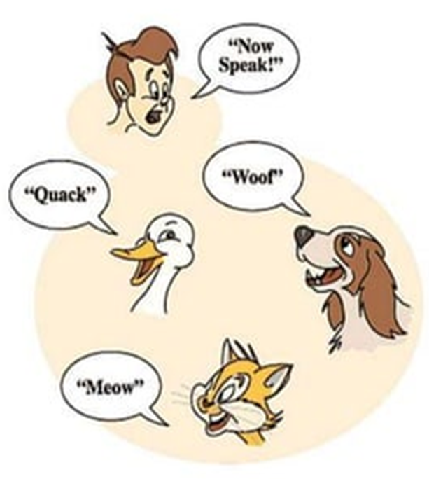
Polymorphism
*
{
If one task is performed by different ways, it is known as polymorphism.
For example: To convince the customer differently, to draw something, like shape, triangle, rectangle, a cat speaks meow. dog barks woof, etc.
Polymorphism present a method that can have many definitions.
Polymorphism is related to
Overloading:- Compile time polymorphism/run time polymorphism
Overriding:- Run time polymorphism/ Dynamic polymorphism
Syntax:
getPrice()
getPrice(string name)
}

Slide 10
Example: Polymorphism
{
// Base class class Animal { public: void animalSound() { cout << "The animal makes a sound \n"; } }; // Derived class class Pig : public Animal { public: void animalSound() { cout << "The pig says: wee wee \n"; } };
// Derived class class Dog : public Animal { public: void animalSound() { cout << "The dog says: bow wow \n"; } };
}

Slide 11
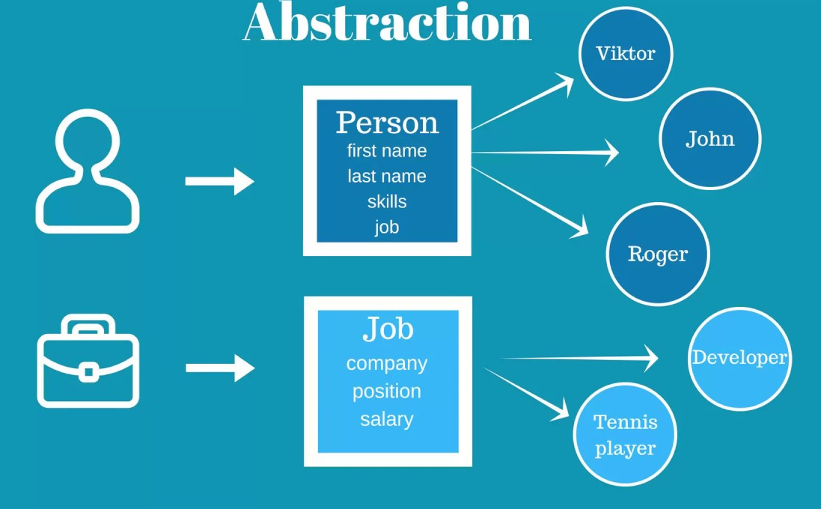
Abstraction
{
..
Abstraction is basically hiding the implementation and gain access to there functionality by exposing by extend keyword.
-An abstract class is a class that may not have any direct instances.
-An abstract operation is an operation that it is incomplete and requires a child to supply an implementation of the operation.
}
..

Slide 12
Example: Abstraction
{
class MyClass { public: // Public access specifier int x; // Public attribute private: // Private access specifier int y; // Private attribute }; int main() { MyClass myObj; myObj.x = 25; // Allowed (public) myObj.y = 50; // Not allowed (private) return 0; };
NOTE:
We can use access specifiers to enforce restrictions on class members. For example:
Members declared as public in a class can be accessed from anywhere in the program.
Members declared as private in a class, can be accessed only from within the class. They are not allowed to be accessed from any part of the code outside the class.
}

Slide 13
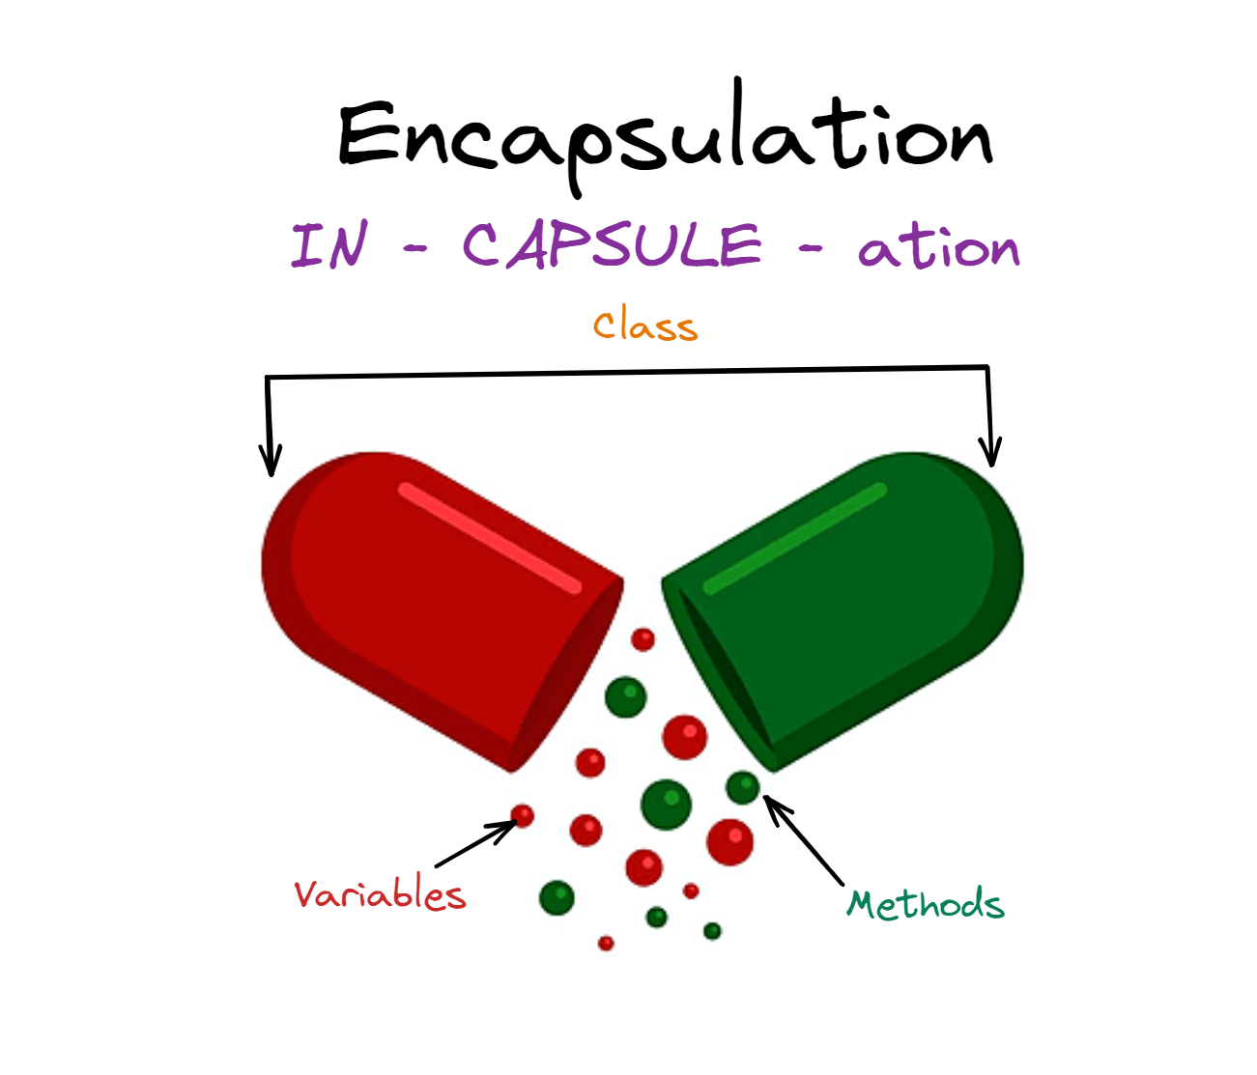
Encapsulation
{
..
Encapsulation in C++ is defined as the wrapping up of data and information in a single unit. In Object Oriented Programming, Encapsulation is defined as binding together the data and the functions that manipulate them.
Consider a real-life example of encapsulation, in a company, there are different sections like the accounts section, finance section, sales section, etc. Now,
- The finance section handles all the financial transactions and keeps records of all the data related to finance.
- Similarly, the sales section handles all the sales-related activities and keeps records of all the sales.
}
..

Slide 14
Example: Encapsulation
{
int main() { Employee myObj; myObj.setSalary(50000); cout << myObj.getSalary(); return 0; }
class Employee { private: // Private attribute int salary; public: // Setter void setSalary(int s) { salary = s; }
// Getter int getSalary() { return salary; } };
To access a private attribute, use public "get" and "set" methods:
}

Slide 15
{
Thankyou
}

